Slide 1

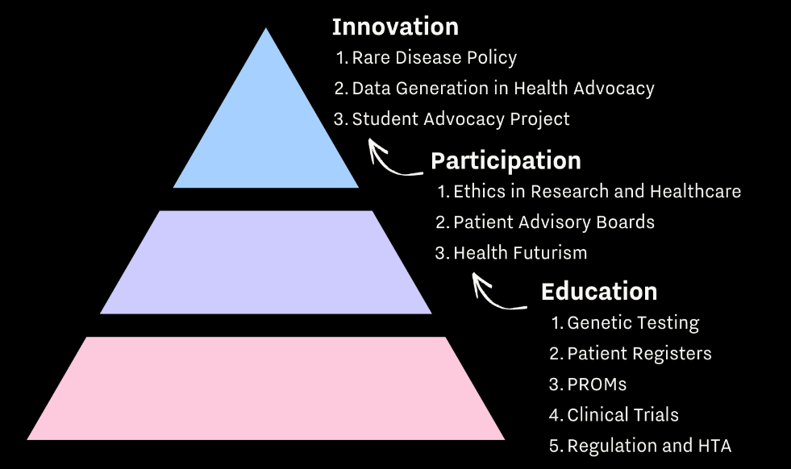
Educate. Participate. Innovate:
Training and empowering patients living with rare, degenerative retinal diseases as active stakeholders in medicines research & development.
Author: Fiona Waters, Education and Engagement Manager, Retina International
Background
There is an increasing demand for patient involvement in medical innovation at research, industry, and policy levels. Retina International (RI) has observed an unmet need amongst its community, where the knowledge and skills to effectively engage in an advisory or advocacy capacity are not developed.
Methods
RI have developed a 3-month training & skills development pilot programme. 11 globally representative trainees, consisting of 9 patient representatives and 2 PhD candidates were selected following application. The curriculum was co-created with subject matter experts (SMEs) and patients. Three learning streams were designed:
Education: Genetic Testing, Patient Registries, PROMs, Clinical Trials, and Regulation & HTA;
Participation: Ethics, Advisory Boards, and Health Futurism; and
Innovation: Rare Disease Policy, Data Generation, and the Student Project, where trainees were tasked with generating data via surveys and designing their own advocacy strategies.
A blended learning approach consisting of independent e-learning, interactive virtual discussion seminars and skills development workshops was used.
Objectives
1. Build knowledge & skills within the retina patient community that enables informed participation in research and innovation
2. Provide opportunity for side-by-side learning of patients and early-career researchers, strengthening and developing crucial relationships
3. Develop a database of patient leaders for referral to advisory and ambassador roles by RI
Results
10 of 11 participants completed the programme. Preliminary findings report increased understanding of the scope, processes, and role of patients in medicines R&D for retinal diseases, and the policy actions that support them.
The breadth and depth of topics covered, as well as the side-by-side learning of patients and researchers was of high value to both groups. The student project was also reported as a highlight of the programme, providing a practical and confidence-building experience.
Curriculum:
Evaluating and Creating
Applying and Analysing
Remembering and Understanding
Conclusions
This pilot programme has demonstrated proof of concept and impact of a tailored and education programme, that develops advisory and advocacy skills in retina patients.
Acknowledgements:
This project is supported by an unrestricted education grant from Janssen Global, Novartis, F. Hoffman La Roche AG, and Biogen.

